Slide 1





Group 8888

Slide 2
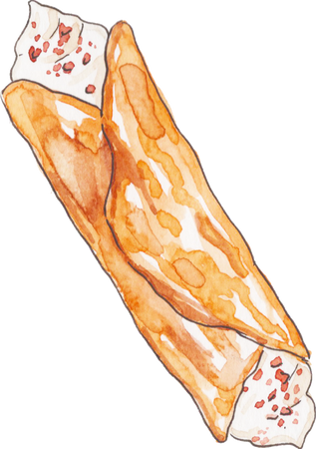



Introduction
Adding Gamification & Social Engagement
Make cooking fun and interactive by adding points, challenges, and sharing features.
Introducing Smart Fridge Inventory & Alarm
Track ingredients easily with expiry alerts and organized storage for healthy cooking
Why This Matters
These features enhance usability and engagement — helping us attract a wider audience and boost app adoption.

Slide 3





features

Slide 4

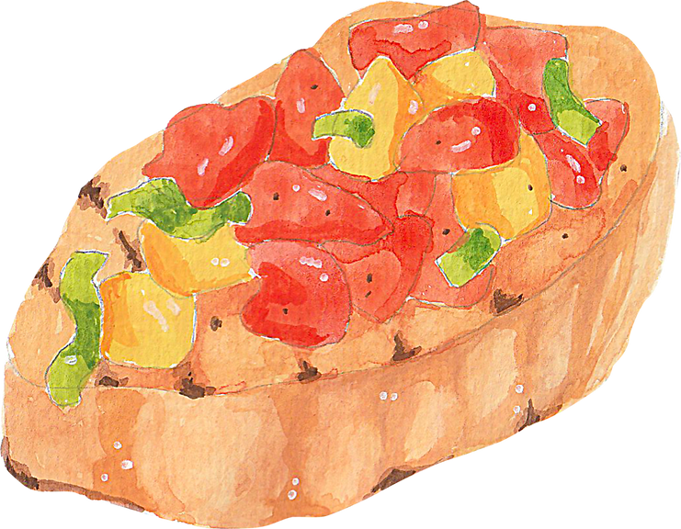
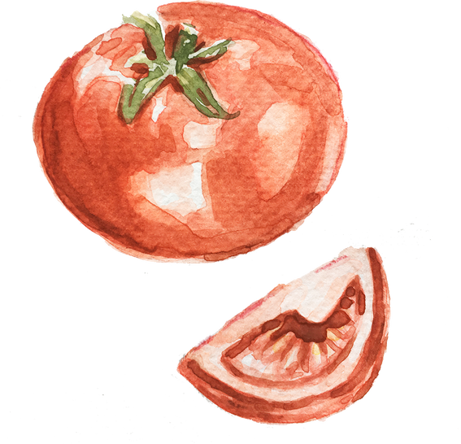


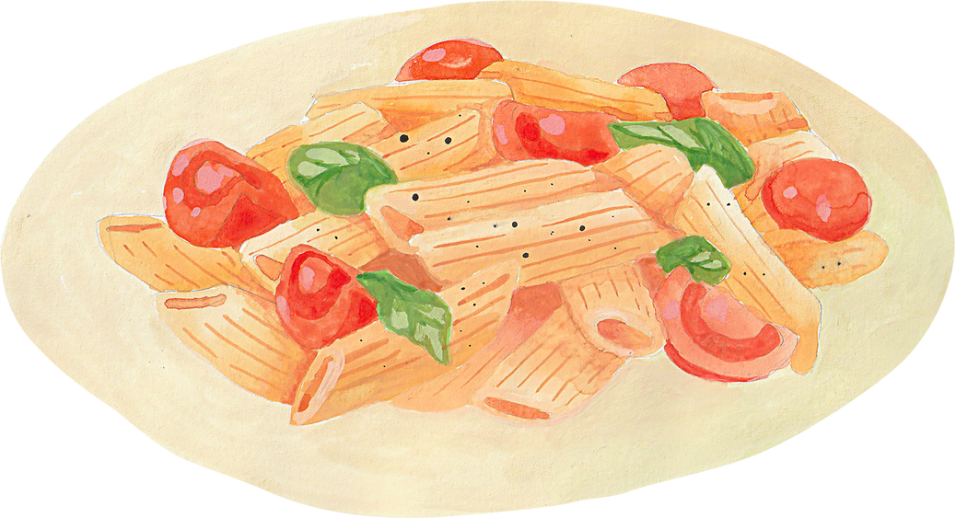

Gamification
Blind box

Slide 5
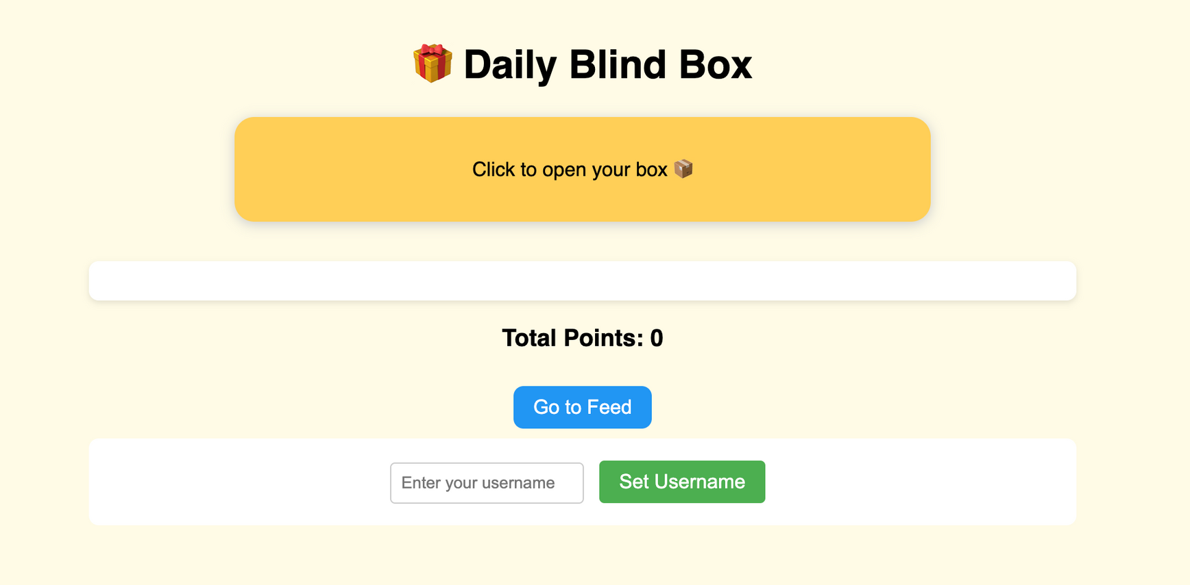
Blind Box

Slide 6



Community engagement

Slide 7
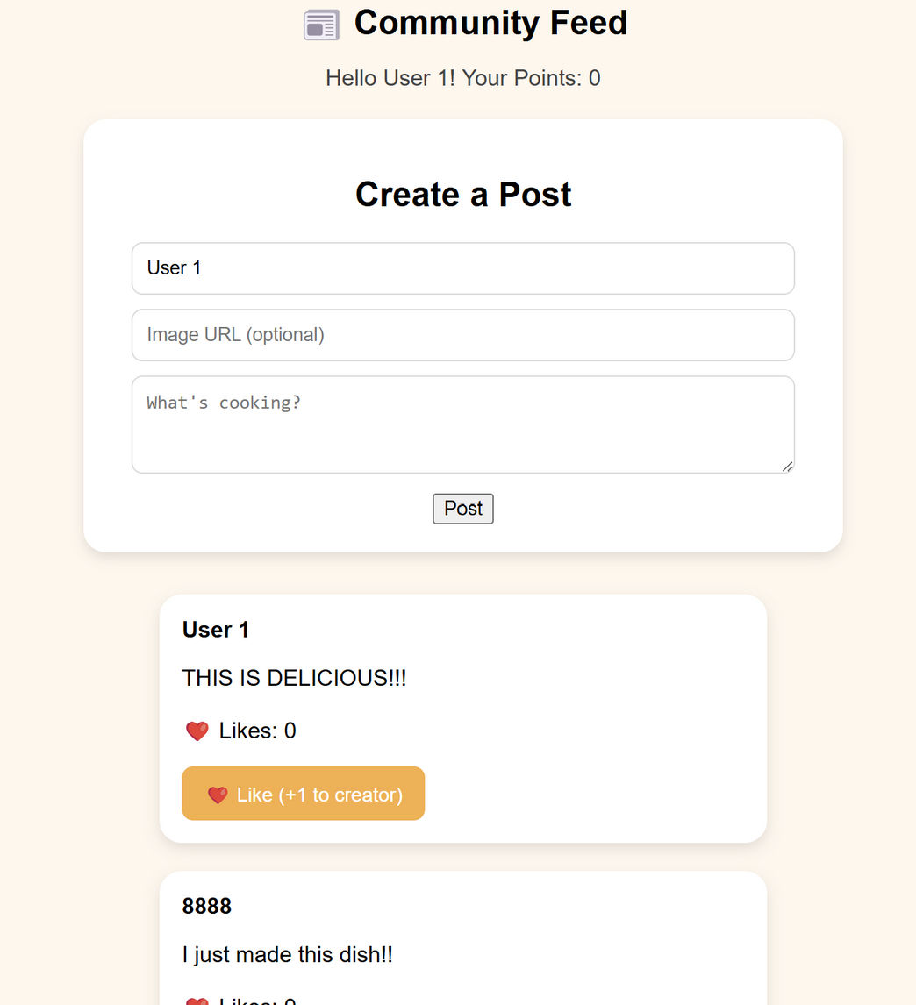
FEED

Slide 8


Additional features

Slide 9

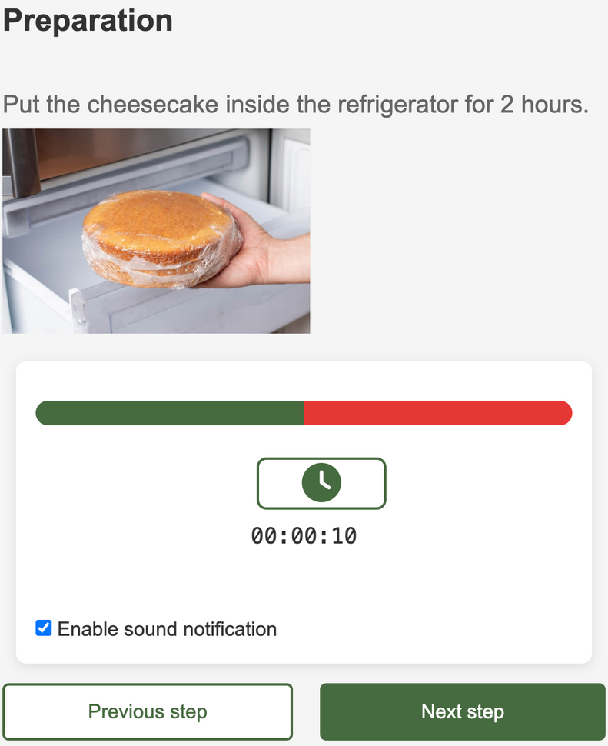

Timer

Slide 10



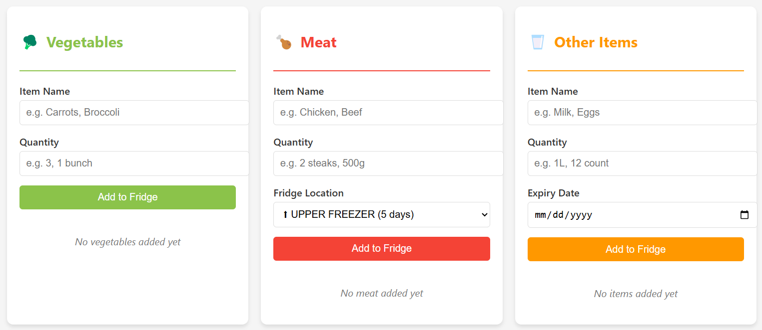
Smart Fridge Inventory
health consicous function
calorie counter
Additional features!

Slide 11




Thank you

